Slide 1


G E N D E R
PAY GAP
R E P O R T
2025
For CPM United Kingdom Ltd
1

Slide 2


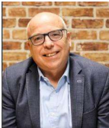
INTRODUCTION
What is the
gender pay gap?
Legislation came into force in April 2017, requiring UK employers with more than 250 employees to publish their Gender Pay Gap.
The Gender Pay Gap looks at the overall pay of men and women, without considering their roles or seniority. This means that the Gender Pay Gap does not provide any insight into Equal Pay, which is the requirement to pay men and women equally for similar work or work of equal value.
“We’re a people business so we know having great people practices and a diverse workforce is key to our success. We are proud to be able to offer a wide variety of roles with varying flexible working patterns for both males and females and we are immensely proud of our balanced gender workforce.
It is hugely important to us to provide all our employees with the opportunity to balance work with other aspects of their lives. We continue to be involved in the ‘Omniwomen’ initiative which focuses on supporting women in leadership. We are promoting multiple Employee Resource Groups which enable people who have lived experience, are an ally or have an interest in a particular experience to find common ground for discussion and support within the business”
I confirm that the figures contained in this report are accurate and have been calculated in accordance with relevant legislation
Richard Worker
Finance Director
Legislative requirements
All UK companies with 250 or more employees on 5 April 2025 are required to publish specific gender pay information:
Mean and median gender pay gap
Mean and median gender bonus gap
Proportion of males and females receiving a bonus
Proportion of males and females by quartile pay band
Figures for each legal entity with at least 250 employees on 5 April 2025 must be calculated and reported separately
The mean and median gender pay gap is based on hourly rates of pay as at 5 April 2025
The mean and median gender bonus gap considers bonus pay received in the 12 months leading up to 5 April 2025
Pay quartiles look at the proportion of men and women in four pay bands when we divide our workforce into four equal parts
2

Slide 3
WHAT IS OUR GENDER PAY
GAP AT CPM?
Mean and median gender pay gap
The mean gender pay gap is the difference in average hourly rates of pay that male and female employees receive. This gives an overall indication of the gender pay gap by taking all hourly rates of pay and dividing by the total number of people in scope.
At CPM, our mean gender pay gap for hourly pay is 15.58%
The median gender pay gap for hourly pay is 23.65%
The median gender pay gap shows the difference in the midpoints of the ranges of hourly rates of pay for men and women by ordering individual rates of pay from lowest to highest and comparing the middle value.
Mean
Gender Pay Gap:
15.58%
Median
Gender Pay Gap:
23.65%
Our median pay gap is 23.65%
Women are overrepresented in our lower paid roles and underrepresented in our higher paid roles. Our senior global executive team are predominantly male, which affects our pay gaps.
Mean and median gender bonus gap
The mean gender bonus gap is the difference in mean bonus pay that male and female employees receive.
We have a range of guaranteed benefits available to all employees that we constantly review. The number of women who received bonus was higher than men.
Mean
Gender Bonus Gap:
40.95%
Median
Gender Bonus Gap:
4.17%
The median bonus gap shows the difference in bonus pay received by the middle woman compared to the middle man.
Proportion of employees receiving a bonus:
Female 50.28%
Male 48.12%
The bonus gap is calculated only from actual bonuses paid. It takes no account of part time workers, or whether someone has worked the full year or not. If someone received no bonus, they are not considered in either the mean or median figures. One factor attributing to our bonus pay gap is the fact that we have more women than men working part-time.
3

Slide 4
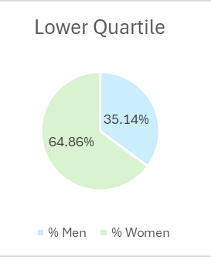
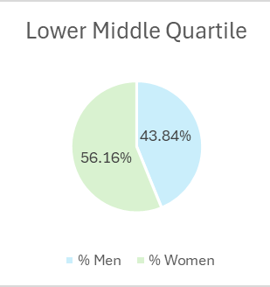
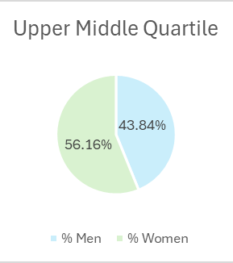
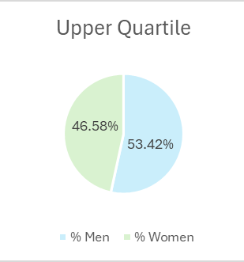
WHY ARE THERE DIFFERENCES?
Proportion of males and females by pay quartile
This is the percentage of male and female employees in four quartile pay bands, (dividing our workforce into four equal parts).
Our workplace is female dominated (56.25% of all employees are women).
Women are overrepresented in our lower paid roles and underrepresented in our higher paid roles
The upper (highest paid) quartile has the lowest proportion of women. All other quartiles are mostly women (at least 55%).
Many of the roles represented in the Lower Quartiles are of a more flexible nature which are more attractive to women.
4

Slide 5





OMNIWOMEN UK
The Omnicom People Engagement Network (OPEN)
For over 15 years, the Omnicom People Engagement Network (OPEN) has been at the forefront of fostering an inclusive and engaging work environment while creating valuable networking and business opportunities. Inclusion and belonging are core to the culture of Omnicom agencies and integral to the work we do.
To underscore our commitment to a gender inclusive environment, we are part of the Omniwomen initiative.
In the UK we have supported an Annual Summit since 2015, a forum where our future female leaders find inspiration and mentorship.
Our goal with this event and its subsequent follow up sessions, known as basecamps, is to foster an environment where women feel they do not need to conform to “traditional” leadership stereotypes to be successful, but instead can be themselves, bringing their own leadership skills and attributes to our companies.
Whilst Gender Pay Gap reporting is focussed on gender equality in the workplace, at CPM we look at all areas of inclusion.
We continue to actively invest in and promote the Omniwomen initiative which is open to all employees across all levels in our business, giving them the opportunity to network, learn and develop.
Top Talent
Omniwomen
Founded 2014, is dedicated to promoting networking and career opportunities for, and developing the skills of, Omnicom’s future female leaders. There are chapters all over the world, including New York, China, the UK and Germany, to name a few!
We run a range of Talent programs and initiatives, designed to help people grow and develop to be their very best. These include our JET program for non managers, My Manager program for new managers and our Transformational Leadership Program for future leaders. Selection to attend is based on merit and equal opportunity is given to all.
We promote managers from within which demonstrates our commitment to providing career opportunities for women in management and leadership positions.
We will continue to review our talent management and succession planning strategies to encourage women into senior leadership positions.
We believe in programs and initiatives that attract the best talent and foster a culture that gives our people the opportunity to succeed.
OPEN Pride
Founded in 2016, OPEN Pride promotes awareness, acceptance and advocacy by creating opportunities for leadership, visibility, community involvement, networking and business. Through its global and local chapters, OPEN Pride works to foster an inclusive and engaging work environment for Omnicom’s LGBTQ+ community and its allies.
5

Slide 6



CPM United Kingdom Ltd
ACTIONS MOVING FORWARD
Inclusion & Impact
Career Development
Recruitment and Attraction
We are committed to creating a workplace where everyone can Join, Grow and Belong. Over the past year, we have strengthened inclusion through actions that promote respect, equity, and belonging.
Our focus includes:
Treating everyone fairly and respectfully
Recognising and celebrating difference
Challenging behaviours that perpetuate stereotypes
Key initiatives:
Courageous Conversations: Open forums for honest dialogue on diversity and inclusion, and raising awareness of intersectionality
Employee Resource Groups: Pride, Neurodiversity, and Women’s Network driving awareness
Education: Inclusive leadership training and eLearning on harassment prevention and neurodiversity
We will continue to promote these initiatives in 2026.
We remain committed to understanding and addressing the challenges women face in building successful careers, including balancing work and family commitments. Retaining and developing female talent is a priority for us.
This year, we have taken significant steps to strengthen career pathways and leadership opportunities:
Growth Partners programme: Selected senior-leaders take part in a Omnicom cross-agency development programme to grow and strengthen leadership capability.
Apprenticeships: We support people at all levels of the business to broaden their business knowledge and develop (leadership) skills for future roles.
JET Programme: Our unified talent development programme for non-managers, designed to build capability and confidence early in careers.
These programmes form part of our wider strategy to create equitable opportunities, nurture diverse talent, and ensure women thrive at every stage of their career.
To reduce our gaps, we need to achieve greater gender diversity across our business, at all levels and departments. We need to ensure we are attracting applicants from women into departments with underrepresentation.
We continue to work with our clients and have specific targets and plans in place to ensure we attract and recruit diverse candidates. We need to make sure that our lower-level roles are attractive prospects for all genders.
We use gender neutral language for adverts and diverse advertising collateral. We invite all hiring managers to do Interview Skills training which includes making hiring managers aware of everyone having natural biases.
We have been working with women candidates to help us to understand:
What we could do better to encourage women to apply for roles
Where we should advertise our roles to ensure we attract women
6
Notes:
We remain committed to understanding and addressing the challenges women face in building successful careers, including balancing work and family commitments. Retaining and developing female talent is a priority for us.
This year, we have taken significant steps to strengthen career pathways and leadership opportunities:
Growth Partners programme: Selected senior-leaders take part in a Omnicom cross-agency development programme to grow and strengthen leadership capability.
Apprenticeships: We support people at all levels of the business to broaden their business knowledge and develop (leadership) skills for future roles.
JET Programme: Our unified talent development programme for non-managers, designed to build capability and confidence early in careers.
These programmes form part of our wider strategy to create equitable opportunities, nurture diverse talent, and ensure women thrive at every stage of their career.

